Slide 1
EE222 Lecture 4
T
Source: Dr. Sangho Shin’s lecture notes, EE222 Winter 2013
The Last Lecture (Lecture 3.5) was given by Prof. Behzad Razavi of UCLA
on RF Circuits

Slide 2
This book provides, for the first time, a broad and deep treatment of the fields of both ultra low power electronics and bioelectronics. It discusses fundamental principles and circuits for ultra low power electronic design and their applications in biomedical systems. It also discusses how ultra-energy-efficient cellular and neural systems in biology can inspire revolutionary low power architectures in mixed-signal and RF electronics. A wealth of insights and examples from cochlear implants, brain implants, systems and synthetic biology, cardiac devices, bio-molecular sensing, and bio-inspired systems, make the book useful and engaging for students and practicing engineers. The book presents a unique, unifying view of ultra low power analog and digital electronics and emphasizes the use of the ultra-energy-efficient subthreshold regime of transistor operation in both. Chapters on batteries, energy harvesting, and the future of energy provide an understanding of fundamental relationships between energy use and energy generation at small scales and at large scales, in biology and in engineering.

Slide 5
Prof. Hugh Herr, MIT
In January 1982, after having ascended a difficult technical ice route in Huntington Ravine on Mount Washington in New Hampshire, Herr and a fellow climber Jeff Batzer were caught in a blizzard and became disoriented, ultimately descending into the Great Gulf where they passed three nights in −20 °F (−29 °C) degree temperatures. By the time they were rescued, the climbers had suffered severe frostbite. Both of Herr's legs had to be amputated below the knees; his companion lost his lower left leg, the toes on his right foot, and the fingers on his right hand.

Slide 6
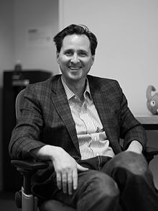
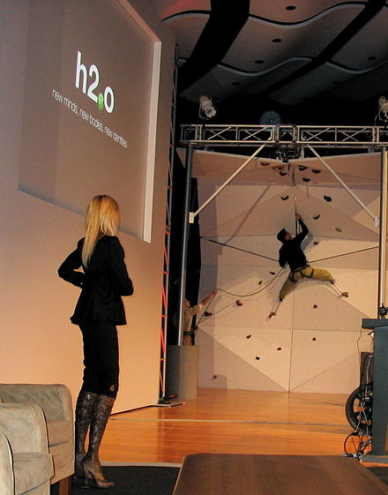
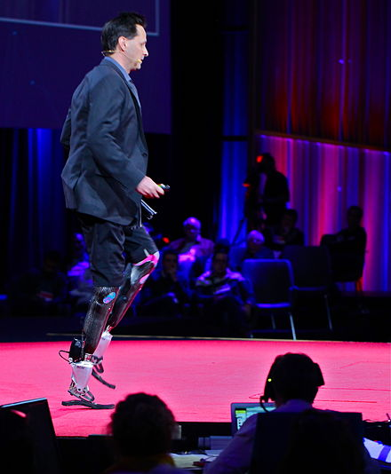
Hugh Herr (born October 25, 1964) is an American rock climber, engineer, and biophysicist.
The youngest of five siblings of a Mennonite family from Lancaster, Pennsylvania, Hugh Herr was a prodigy rock climber: by age eight, he had scaled the face of the 11,627-foot (3,544 m) Mount Temple in the Canadian Rockies, and by 17 he was acknowledged to be one of the best climbers in the United States.^{[1]}
In January 1982, after having ascended a difficult technical ice route in Huntington Ravine on Mount Washington in New Hampshire, Herr and a fellow climber Jeff Batzer were caught in a blizzard and became disoriented, ultimately descending into the Great Gulf where they passed three nights in −20 °F (−29 °C) degree temperatures. By the time they were rescued, the climbers had suffered severe frostbite. Both of Herr's legs had to be amputated below the knees; his companion lost his lower left leg, the toes on his right foot, and the fingers on his right hand. During the rescue attempt, volunteer Albert Dow was killed by an avalanche.^{[1]}
Following months of surgeries and rehabilitation, Herr was doing what doctors told him was unthinkable: climbing again. Using specialized prostheses that he designed, he created prosthetic feet with high toe stiffness that made it possible to stand on small rock edges the width of a coin, and titanium-spiked feet that assisted him in ascending steep ice walls. He used these prostheses to alter his height to avoid awkward body positions and to grab hand and foot holds previously out of reach. His height could range from five to eight feet. As a result of using the prostheses, Herr climbed at a more advanced level than he had before the accident, making him the first person with a major amputation to perform in a sport on par with elite-level, able-bodied persons.^{[2][3]}
Hugh Herr
Herr in 2013
Born
Hugh Miller Herr October 25, 1964 (age 52)
Lancaster, Pennsylvania, U.S.
Nationality
American
Fields
Biophysics Mechanical engineering Physics
Institutions
Massachusetts Institute of Technology
Alma mater
Millersville University Massachusetts Institute of Technology Harvard University
Website media.mit.edu/people/hherr
Hugh Herr is married to author Patricia Ellis Herr and has two daughters, Alexandra and Sage. Alex's earliest hiking achievements are described in Patricia's memoir, Up: A Mother and Daughter's Peakbagging Adventure (Broadway Books, April 2012).
After his climbing career, Herr began to focus on academics, previously an area of little interest to him. He earned an undergraduate degree in physics at his local college, Millersville University, and a master's degree in mechanical engineering at MIT, followed by a PhD in biophysics from Harvard University.
Hugh Herr
Herr in 2013
Born | Hugh Miller Herr October 25, 1964 (age 52) Lancaster, Pennsylvania, U.S.
Nationality | American
Fields | Biophysics Mechanical engineering Physics
Institutions | Massachusetts Institute of Technology
Alma mater | Millersville University Massachusetts Institute of Technology Harvard University
Website media.mit.edu/people/hherr

Slide 7
iWalk Inc. Products

Slide 11
https://kmatrix.kaist.ac.kr/dr-m-integrated-mobile-healthcare-technology/

Slide 12
https://kmatrix.kaist.ac.kr/dr-m-integrated-mobile-healthcare-technology/
Cyber telemedicine systems were established in homes and hospitals within the testbed so that users are remotely connected with doctors at hospitals and can receive medical service in a convenient manner based on information collected from their daily lives. Dr. M researchers are demonstrating a service scenario showing that they can collect and store information not only about sleeping, weight management, and blood pressure but also about heart rates and body temperature through non-contact measurement in homes. When users receive telemedicine service from doctors who are located at hospitals, they can share their information with the doctors and receive feedback about their health information.

Slide 13
https://kmatrix.kaist.ac.kr/dr-m-integrated-mobile-healthcare-technology/

Slide 18
A 40 mV Transformer-Reuse Self-Startup Boost Converter With MPPT Control for
Thermoelectric Energy Harvesting
Author(s)
Jong-Pil Im ; Se-Won Wang ; Seung-Tak Ryu ; Gyu-Hyeong Cho
Abstract:
This paper presents transformer-based self-starting boost converter architecture with low-power maximum
power point tracking (MPPT) control for low-voltage thermoelectric generator applications. The minimum
working voltage of the proposed boost converter is 40 mV with oscillation through a positive feedback loop
formed by a native MOS and transformer. The oscillation autonomously starts up by thermal noise and
V_{OUT} is charged up to 1.2 V by the oscillation so that the control block can operate.
After that, the transformer for start-up is reused as an inductor, and the normal boost converter mode is
enabled for better energy transfer efficiency. An improved MPPT sensing method is also proposed to
simplify the circuit. The prototype chip is implemented in a 0.13-μm CMOS process. It operates with an
input voltage range of 40 mV to 300 mV and provides a maximum output power of 2.7 mW with a maximum
efficiency of 61% at an output voltage of 2 V.
Published in: IEEE Journal of Solid-State Circuits ( Volume: 47, Issue: 12, Dec. 2012 )
Page(s): 3055 - 3067
Date of Publication: 12 December 2012

Slide 23
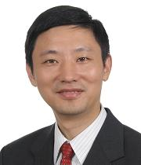
Provost's Chair Professor, IEEE Fellow Area Director, Integrated Circuits and Embedded Systems
Department of Electrical and Computer Engineering

Slide 24
CMRR(Common Mode Rejection Ratio)= not passing the portion of the signal common to both + and – terminals of differential amp.
PSRR(Power Supply Rejection Ratio)= ability of DC power supply to maintain its output as DC= change in Vcc/change in Vout .

Slide 33
(Operational Transimpedance Amplifier)

Slide 34
SAR=Successive Approximation Register

Slide 36
ZigBee= wireless language that everyday devices use to connect to one another.

Slide 37
UWB(Ultra wide band) for transmitting information spread over a large bandwidth >500 MHz

Slide 42
Retinal Prosthesis
Annual Review of Biomedical Engineering
Vol. 7:361-401 (Volume publication date 15 August 2005) First published online as a Review in Advance on March 17, 2005 DOI: 10.1146/annurev.bioeng.7.060804.100435
James D. Weiland,¹ Wentai Liu,² and Mark S. Humayun¹
¹Doheny Retina Institute, Department of Ophthalmology, Keck School of Medicine and Department of Biomedical Engineering, Viterbi School of Engineering, University of Southern California, Los Angeles, California 90089; email: jweiland@doheny.org, mhumayun@doheny.org
²Department of Electrical Engineering, Baskin School of Engineering, University of California, Santa Cruz, California 95064; email: wentai@soe.ucsc.edu
LITERATURE CITED
Abstract
▪ Abstract Retinal prostheses represent the best near-term hope for individuals with incurable, blinding diseases of the outer retina. On the basis of the electrical activation of nerves, prototype retinal prostheses have been tested in blind humans and have demonstrated the capability to elicit the sensation of light and to give test subjects the ability to detect motion. To improve the visual function in implant recipients, a more sophisticated device is required. Simulations suggest that 600–1000 pixels will be required to provide visual function such as face recognition and reading. State-of-the-art implantable stimulator technology cannot produce such a device, which mandates the advancement of the state of the art in areas such as analog microelectronics, wireless power and data transfer, packaging, and stimulating electrodes.

Slide 45
arXiv:1509.00940v2 14Nov2015
IEEE COMMUNICATIONS SURVEYS AND TUTORIALS, TO APPEAR 1
Wireless Charging Technologies: Fundamentals, Standards, and Network Applications
Xiao Lu†, Ping Wang‡, Dusit Niyato‡, Dong In Kim§, and Zhu Han≀ † Department of Electrical and Computer Engineering, University of Alberta, Canada ‡ School of Computer Engineering, Nanyang Technological University, Singapore § School of Information and Communication Engineering, Sungkyunkwan University (SKKU), Korea ≀ Electrical and Computer Engineering, University of Houston, Texas, USA.
Abstract—Wireless charging is a technology of transmitting power through an air gap to electrical devices for the purpose of energy replenishment. The recent progress in wireless charging techniques and development of commercial products have provided a promising alternative way to address the energy bottleneck of conventionally portable battery-powered devices. However, the incorporation of wireless charging into the existing wireless communication systems also brings along a series of challenging issues with regard to implementation, scheduling, and power management. In this article, we present a comprehensive overview of wireless charging techniques, the developments in technical standards, and their recent advances in network applications. In particular, with regard to network applications, we review the static charger scheduling strategies, mobile charger dispatch strategies and wireless charger deployment strategies. Additionally, we discuss open issues and challenges in implementing wireless charging technologies. Finally, we envision some practical future network applications of wireless charging

Slide 46
SUMMARY OF EXISTING SURVEY IN RELATED AREA.
Survey Scope Main Contribution
[9] Wireless network with RF energy harvesting-Review of i) fundamentals and circuit design for RF energy harvesting, ii) resource allocation schemes and communication protocols for various types of RF-powered wireless network, and iii) practical challenges and future directions.
[10] Wireless network with energy harvesting- Review of i) information-theoretic physical layer performance limits to transmission scheduling policies and medium access control protocols, ii) emerging paradigm of energy transfer and cooperation that occur separately or jointly with information transfer, and iii) energy consumption models for energy harvesting communication systems. [12] Sensor nodes with energy harvesting- Review of architectures, energy sources and storage technologies, as well as applications of sensor nodes with energy harvesting.
[13] Devices with ambient energy harvesting- Review of i) various types of energy harvesting techniques, ii) different energy harvesting models, and ) power management and networking aspects of the energy harvesting devices.
[14] RF/microwave energy harvesting circuit- Review of i) basics and designs of the RF energy harvesting circuit, and ii) energy conversion efﬁciency of existing implementations of RF energy harvesting circuits.

Slide 47
COMPARISON OF HARDWARE IMPLEMENTATIONS OF INDUCTIVE COUPLING.
Implementation Technique/Output/Maximum Charging Efﬁciency/Maximum Charging Distance/Frequency
Yoo et al [222] (2010) 0.18µm CMOS/ 1.8V/ 54.9%/ 10mm /13.56MHz
Lee et al [223] (2012) 0.5µm CMOS /3.1V/ 77%/ 80mm/ 13.56MHz
Lee et al [224] (2013) 0.18µm CMOS /3V /87% /20mm /13.56MHz
Lazaroet al [225] (2013) 0.18µm CMOS /1.5V /82% /11.35mm /100-150kHz
Li et al [226] (2014) 0.13µm CMOS/ 3.6V /65% /20mm /40.68MHz
COMPARISON OF HARDWARE IMPLEMENTATIONS OF MAGNETIC RESONANCE COUPLING.
Implementation Transmit Coil Diameter/Receive Coil Diameter/Charging Distance/ Charging Efﬁciency /Frequency
Kurs et al [39] (2007) 60×60cm/ 30×30cm/ 75cm/ 93% /9.9MHz
Low et al [55] (2009) 21×21cm /13×13cm /1cm/ 75.7% /134kHz
Wang et al [227] (2012) 30×30cm/ 30×30cm /5mm /74.08% /15.1MHz
Ahn et al [228] (2013) 35×30cm/ 31.5×22.5cm /20-31cm/ 45-57% /144kHz
Ali et al [229] (2014) 13.6×13.6 cm/ 5×5cm /3mm /88.11%/ 22.2-22.4MHz

Slide 48
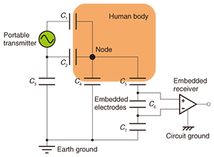
Circuit Model of Human Body

Slide 73
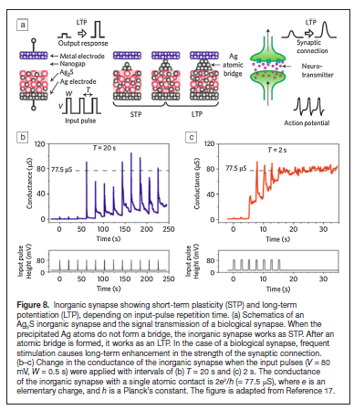
Synapse and Memristortw
.
Ref. D. B. Strukov, Nature 476, 403 (2011)

